Slide 1

Coalition of NYS Health Homes Monthly Full Membership Meeting
Laurie Lanphear, Executive Director
September 4, 2026

Slide 2
Agenda
Announcements
Health Home Advocacy
Health Home Policy
HH Coalition Workgroups
Ask a Health Home

Slide 3
Announcements
UHF Medicaid Conference
  Resources
    Conference Summary: UHF Medicaid Conference Explores Strengthening Program Through Partnership, Innovation, and Trust | United Hospital Fund
    Presentation Slides: Potential format for Keynote Address at UHF Conference 7/30
    Conference Recording: https://www.youtube.com/watch?v=ggibQDENLfI
HHCM Workforce Survey 2026

Slide 4
Announcements
H.R.1 Planning (DOH Data Request)
  Coalition requested enrollment data by:
    Coverage type: FFS, MMC, HARP, MLTC
    Eligibility group: TANF, SSI, MAGI/Non-MAGI
    Adult vs. child populations
Notes:
MAGI-Expansion- Non-MAGI disabled,

Slide 5

Health Home Care Management Rally at the Capitol

Slide 6
Health Home Care Management Rally at the Capitol
Messaging: Please join the NYS Care Management Coalition, Coalition of NYS Health Homes, and iHealth for an important conversation focused on Health Home Care Management:
  HEALTH HOME CARE MANAGEMENT: OUR VOICES, YOUR CARE
    Wednesday, October 7, 2026
    11:00 AM – 1:00 PM
    The War Room, 2nd Floor
    NYS Capitol | Albany, NY
  This gathering is an opportunity for Health Home stakeholders to come together, share our voices, and highlight the essential role of Health Home Care Management in supporting New Yorkers and the communities we serve.
  Boxed lunches will be available. Transportation is available from NYC and indicated on the reservation.
  Please RSVP using the QR code on the attached invitation or HHCM Rally at the Capitol Registration Link
  We hope you’ll join us in Albany and add your voice to this important conversation. We also encourage you to share the invitation with appropriate members of your organization.
  We look forward to seeing you on October 7!

Slide 7
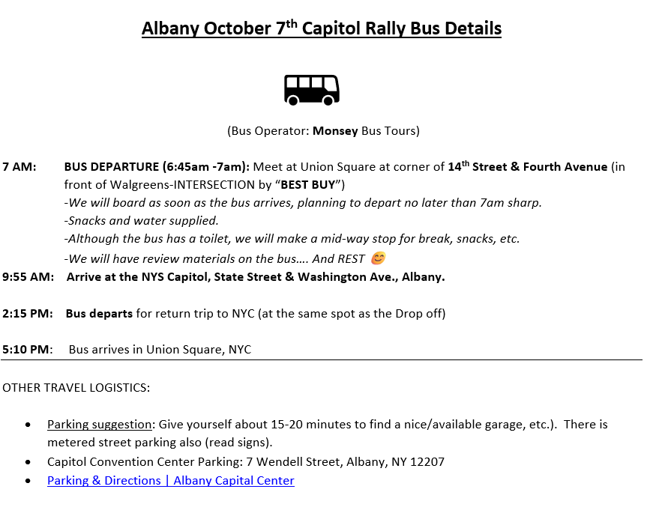
Health Home Care Management Rally at the Capitol- NYC Transportation Details

Slide 8
Health Home Care Management Rally at the Capitol
What We Need From Members
  Share invite internally and within your networks
  Identify care manager/member speakers
  Indicate if using NYC transportation early

Slide 9
HHCM Actuary Analysis
Health Home Coalition: Overlapping Care Management Costs Analysis
Purpose of the Analysis:
  Evaluate potential overlap in care management payments between Health Homes and Medicaid managed care plans.
  Identify opportunities to better align funding with the Health Home as the provider of intensive, community-based care management.
  Support discussion with DOH on strengthening the Health Home infrastructure while addressing concerns about Medicaid spend, overlap, and duplication.
    Highlight flat funding since 2018- investment opportunities

Slide 10
HHCM Actuary Analysis
What the Analysis Includes:
  Rate Development Review Across Three Plan Types (Excluded SNP)
    The Coalition worked with HMA actuaries to review care management costs included in:
      Mainstream Medicaid Managed Care (MMC)
      Managed Long Term Care (MLTC)
      Health and Recovery Plans (HARP)
    The analysis reviewed projected care management PMPM amounts and applied those amounts to Health Home enrollment by plan type.
Key Findings:
  Estimated Potential Overlapping Payments
    Estimated annual overlapping care management payments: $98.3 million.
    Health Home members reviewed across MMC, MLTC, and HARP.
    Largest estimated overlap is within MLTC due to the higher care management PMPM included in MLTC rates.

Slide 11
HHCM Actuary Analysis- Health Home Value
Demonstrated Outcomes and Cost Avoidance
  Health Homes provide intensive, community-based care management for high-risk complex need members and have demonstrated:
  Reduced inpatient utilization: -32.5%
  Reduced emergency department utilization: -18.5%
  Reduced skilled nursing facility amount: -44.7%
  Estimated inpatient cost avoidance of approximately $1,170 PMPY after 9+ months of continuous enrollment and $185 per-member-per-year estimated savings associated with potentially preventable readmission reduction.
Recommendation for Discussion:
Align Funding and Functional Responsibility
  Reduce the care management portion of plan non-medical funding to account for Health Home enrollment.
  Shift those dollars to Health Homes to support program sustainability.
  Formally recognize Health Homes as the care management entity for members enrolled in Health Home Care Management.

Slide 12
Quarterly Strategic Meeting DOH
Last Meeting: June 5
Next Meeting: October 22
October Priority: Review actuary analysis and opportunities to streamline care management statewide.
Continuing Strategic Priorities:
  Workforce/administrative simplification
  Children’s BH continuum
  Federal Medicaid landscape

Slide 13
Background Checks HHSA 18-21
HHSA Ages 18–21: How Are Health Homes Ensuring Background Check Compliance?
  Enrollment of members in this age group occurs at a relatively low frequency but is distributed across Health Homes and CMAs statewide.
  In absence of IRAMS reporting requirements how are HH’s ensuring CMA compliance?
    Policy
    Audits
    Attestations
  What challenges are you encountering without IRAMS reporting

Slide 14
Health Home Redesignation
What Changed / What Didn’t
  Movement from DOH
    Integrated EHR concerns can be addressed case-by-case
    Two HH+ measures temporarily weighted at 0%
  Still Unresolved
    No routine advance Domain 3 member list
    Children’s HCBS CTQA weighting remains at 7%
    Broader HH+ scoring concerns remain
.

Slide 15
Health Home Policy HH+
PSYCKES Flags
MAPP/IT Subcommittee working through the issues
Clinical Discretion
NYC Coordination

Slide 16
DOH Policy Updates and Health Home Billing
Comprehensive Assessment- Health Home Billing
  The updated 5/25 policy added underlined language; although it was NOT identified in the official DOH "Guide to Edits":
    For both Health Homes Serving Adults and Health Homes Serving Children, the initial Comprehensive Assessment is to be completed concurrently with an initial Plan of Care within fifty-six (56) calendar days of enrollment in order for billing to proceed.
  For comparison, the previous DOH policy stated:
    The initial comprehensive assessment must be completed concurrently with an initial plan of care within 60 calendar days of enrollment. An assessment may be completed over the course of several days; at least one encounter during the initial assessment period must be face-to-face. Health Home policy must clearly identify required timeframes and implement quality review to ensure adherence.
  Below is the language from the OMIG audit protocols (April 1, 2026):
    Missing Comprehensive Assessment: If the care management record does not contain an initial comprehensive assessment, and if applicable, an annual reassessment has not been completed or completed following a significant change in the member's health, behavioral health, or social needs, the claim will be disallowed. If the comprehensive assessment is not made available, the claim will be disallowed.
  Open call for workgroup to address policy updates

Slide 17
DOH Policy Updates and Health Home Billing
POC- Health Home Billing
  January 2025 formal policy guidance regarding POC signatures and MAPP uploads was issued.
  June 2024 DOH referenced presentations and system changes to accommodate billing blocks.
  How are HH’s managing self-disclosures during audits if POC is missing signature?

Slide 18
Coalition Workgroup Updates
Health Home Data Analysis Workgroup
  Last Meeting August 13, 2026
  Next Meeting September 28, 2026
  Focus
    AI in Health Homes (Standing agenda item)
    Prepare Executive Summary for advocacy on statewide Health Home quality management and oversight.
    Present to DOH/OMH on work happening in Health Homes statewide- HH Office Hours October 2026
Health Home-SCN Collaboration Workgroup

Slide 19
Ask a Health Home
Managing HH-to-HH Transfers in MAPP
  Varying practices across HH’s, some requesting disenroll the members and then refer them to the receiving HH so they're able to receive them in Outreach instead.
    Are there issues with the HH-to-HH transfer in MAPP that we should be aware of?
DOH 5055
  Can we modify Page 4? (Add initials/date for each line)
  Can we pre-populate provider types? (e.g., Hospital, MCO, PCP, Behavioral Health, etc.)
  What exactly is required when providers are pre-listed vs. added during the meeting?
    If providers/entities are pre-listed before the member meeting, must the member/consenter and HHCM initial and date each approved entity?
    If the Page 4 is blank and the HHCM adds providers/entities during the member meeting, is the member's approval/signature/initial and date at the designated Page 4 section sufficient, or must the member and HHCM also initial/date each entity added during the meeting?

Slide 20

Thank You!

